Slide 1
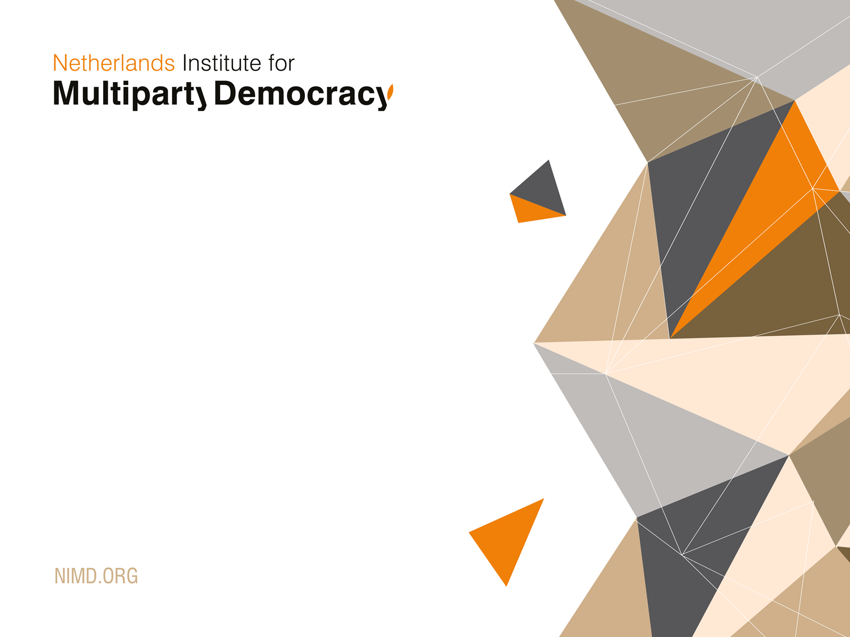
Challenges (and good practices) of working on Inclusive Governance:
The Case of Dialogue for Stability

Slide 2

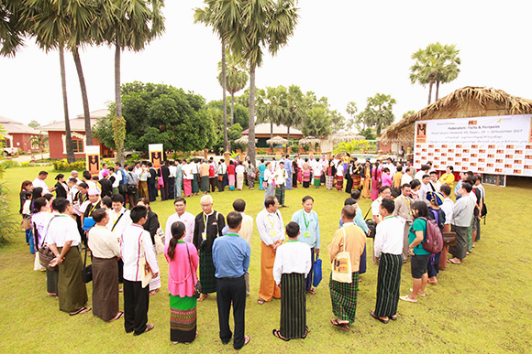
NIMD WORKS TO PROMOTE PEACEFUL,
JUST AND INCLUSIVE POLITICS WORLDWIDE

Slide 3
NIMD WORKS TO PROMOTE PEACEFUL,
JUST AND INCLUSIVE POLITICS WORLDWIDE
https://www.youtube.com/watch?time_continue=14&v=5PEdhHBbXYM

Slide 4


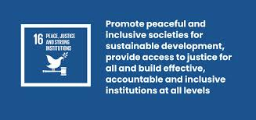
NIMD WORKS TO PROMOTE PEACEFUL,
JUST AND INCLUSIVE POLITICS WORLDWIDE
Notes:
Inclusive Responsive Accountable Effective Political Actors – Inclusive governance

Slide 5
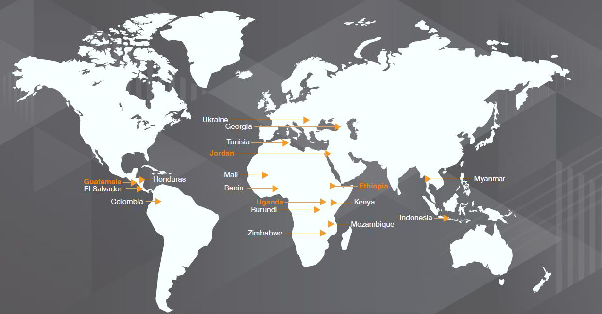
Where we work
18 country programmes
Fragile or emerging democracies

Slide 6

Dialogue for Stability Programme
2016-2020
Objective: Fostering inclusive and legitimate political systems in Burundi, Colombia, Jordan, Tunisia and Ukraine
Donor: Dutch Ministry of Foreign Affairs
Duration: 5 years
Budget: €15 million - Includes support for Knowlegde Unit
Theory of Change aims at change on three interrelated levels:
System – Actor – Culture

Slide 7
Theory of Change (pathways)
SYSTEM
ACTOR
Inclusive political systems that contribute to stability
Legitimate and capable political actors
Inclusive and legitimate political systems in fragile settings
CULTURE
Political practice
is informed by
democratic
values

Slide 8
Theory of Change (interventions)
Burundi
INTER-PARTY
PARTY
Dialogue for political reform
Capacity and institution building
POLITICAL ARENA
Tunisia
Colombia
INDIVIDUAL
Democracy Schools
and ‘socialization’
Notes:
Show briefly three examples of from the programme

Slide 9
Combining Dialogue and Party Strengthening
Burundi
INTER-PARTY
PARTY
Dialogue for political reform
Capacity and institution building
POLITICAL ARENA
INDIVIDUAL
Democracy Schools
and ‘socialization’
Notes:
In principle all programmes focus on three levels, but Burundi prime focus on dialogue and part cap

Slide 10
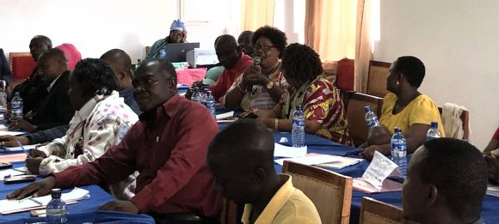
Burundi
Extremely polarized setting
Instable political settlement after conflict and the dominant party increasingly closed
Programme focuses on the conditions for dialogue between the different political parties
Trusted local partner: BLTP
Linked to long-term organizational development of political parties
Challenge: How to be inclusive in situation where dominant party opposes inclusion?
Notes:
Nonruling parties in FCAS have little support and are often shut out from being able to participate in the political space This dynamic is often further exacerbated by the integration of former armed movements

Slide 11
Burundi – inclusive dialogue between parties
Main accomplishments
Creating and preserving a ‘political space’ for interparty dialogue in a very complex political environment
Opposition parties did not boycott referendum campaign on constitutional amendments which passed off peacefully; direct result of NIMD/BLTP’s work to embed non-violent communications and constructive political party engagement
So the process itself is a result, and a non-event can be a result as well….

Slide 12
Burundi – inclusive dialogue between parties
Lessons:
Focus on less politically contentious issues. Keeping in contact with ruling party and to keep dialogue going more important ->Trustbuilding as means and a goal
Sticking to (horizontal) inclusion necessary but also makes life more difficult – ‘inclusive enough’ would at least include the ruling party
Shifted implementation to the local (colline) level away from central party level
Used regular political analysis (local, international experts, diaspora) to inform way forward
Theory of Change needs regular updating – not always easy

Slide 13
Combining political conversion to party and democracy education
INTER-PARTY
PARTY
Dialogue for political reform
Capacity and institution building
POLITICAL ARENA
Colombia
INDIVIDUAL
Democracy Schools
and ‘socialization’

Slide 14
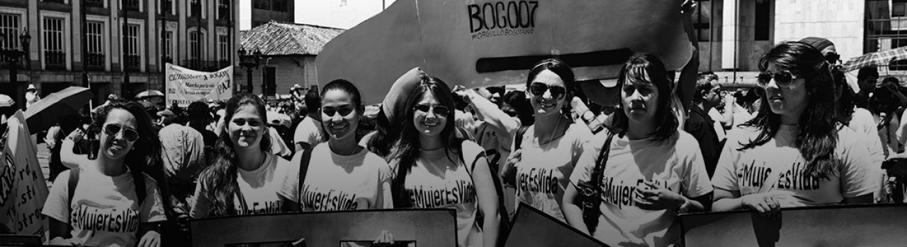
Colombia – political inclusion and peace
Long history of conflict, several armed actors, formal peace negotiations, and a difficult peace agreement finally accepted but under pressure
NIMD country office managed to build political network and become trusted partner and interlocutor
Challenge: How to facilitate the political inclusion of an armed movement while addressing the issues in the Peace Accord?

Slide 15
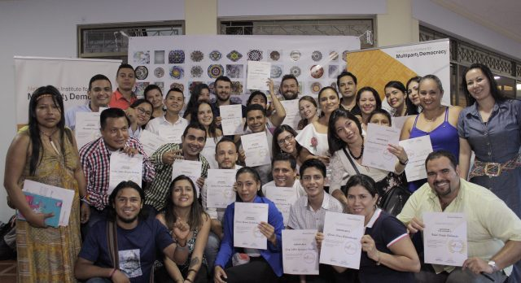
Colombia – political inclusion and peace
Some accomplishments:
NIMD given a specific role in the Technical Secretariat to help with the implementation of the Peace Agreement that the Government of Colombia signed with the Fuerzas Armadas Revolucionarias de Colombia (FARC) in 2017.
This illustrates the kind of trust and recognition that NIMD has been able to build
Able to start conflict mediation and reconciliation initiatives on local level to create space for dialogue between political parties. In a region with long history of violent confrontations between guerrillas, paramilitaries and state forces able to address contentious issue and overcome the wounds of sixty years of conflict

Slide 16
Colombia – political inclusion and peace
Lessons:
Being an external actor in general is a disadvantage but can also be an opportunity – seen by the political actors as acceptable interlocutor
Being able to link to an international network and experiences (conversion, peace building, dialogue) helps
Again, decentralised approach gives more political manoeuvring space, but practically more challenging
High impact on security measures – initially underestimated
This approach also enabled a larger support programme to support the peace and political integration of the FARC

Slide 17
Combining a School of Politics and Dialogue Platform
INTER-PARTY
PARTY
Dialogue for political reform
Capacity and institution building
POLITICAL ARENA
Tunisia
INDIVIDUAL
Democracy Schools
and ‘socialization’
Notes:
Linking dialogue to successful School of Politics

Slide 18
Tunisia – fostering a new generation of democrats
Growing pains after the Arab Spring rapid opening up of the political system
Democracy under pressure to ‘deliver’
Co-founded the Tunisia School of Politics
Under DfS moving towards dialogue between parties
Notes:
Note – Colombia programme has taken much more of a peacebuilding role

Slide 19
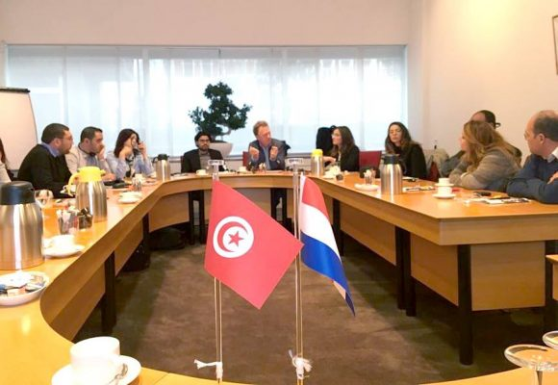
TSoP
  Objective: A new generation of political leaders with a strong understanding of democratic values and the importance of dialogue and cooperation.
  Started in 2012, together with Demo Finland and CoE
  Ten most relevant parties nominate, final selection against preset criteria
  Implemented by CEMI, respected institute
  Focus on skills, knowledge and values

Slide 20
TSoP
  Some achievements
  At least 1/3 of alumni of the Tunisian School of Politics become more influential in their own parties (currently 400)
  Several alumni became ministers or state secretaries (including two women)
  In 2018, 61 alumni ran for the municipal elections, including 32 women – In the end 27 were elected, 11 women.
  Next: 2019 parliament elections

Slide 21
Tunisia – moving towards dialogue
  Based on the succes of TSoP, trust is built to engage parties in Interparty Dialogue
  Platform established in 2016 to facilitate discussion on democratic reforms and linking parties to thematic expertise
  First achievements
  Ability to convene all parliamentary parties in dialogue platform
  Willingness of political parties to discuss sensitive issues around the 2018 municipal elections in the dialogue platform
Charter on municipal elections agreed
Agreements between 14 parties on acceleration of the ratification of the law on decentralization.
Complemented by informal ‘Couscous Politique’
Key lesson: Democracy Education as foundation for dialogue

Slide 22
Lessons and good practice
SYTEM
ACTOR
Long term, local experts, inclusion
Link to dialogue, needs-based
ADAPTIVE PROGRAMMING
CULTURE
Cross party alumni
networks as
foundation
Notes:
Linking dialogue to successful School of Politics

Slide 23
Overall success factors
Common TOC and country PEA
Flexibility (including of the donor)
Local organisations and individuals with the right skills and mindset
Intuitive political nature of staff
Room for experimentation and adaptation
Holistic approach (S-A-C) works, but makes for challenging programming

Slide 24
Challenges & Dilemmas
How to avoid over-reliance for implementation on key individuals and ‘institutionalise their intuition’
How to use politically astute tools (PEA) without making it about the tool
How to avoid finding problems for preset solutions (keeping it truly adaptive)
How to balance inclusion of dialogue participants, the (active) participation of them, and the meaningfulness of issues on the table

Slide 25
